Slide 1

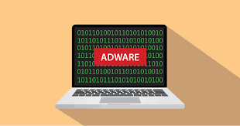
Adware Detection In Android System
By :-
Ankit kr. Mishra [200250329003]
Nishank Shukla[200250329010]
Guided By:-
Mr. Sandip Shivaji Kale
Project Engineer | E-security
CDAC Hyderabad

Slide 2

What Is Adware ?
Adware is also known as advertisement-supported software. Creators ofadware include advertisements or help distribute other software to earn money.
An adware virus is considered a PUP (potentially unwanted program), which means it’s a program that is installed without express permission from the user.
Adware is more annoying than dangerous .There are also cases where adware can collect your data .
Adware opens the door for attackers to add other malicious functionality in the future that could endanger users' data or accounts.
Adware is a type of malware that bombards you with endless ads and pop-up windows that could potentially be dangerous for your device.

Slide 3
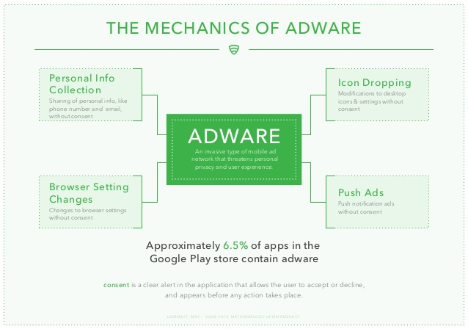
Mechanics Of Adware :

Slide 4
Types of Adware :
On-Site Adware
Adware from a Downloaded Program
When you download freeware or shareware, oftentimes adware is included .
These free versions programs use adware to fund development and distribution.
This type of adware doesn’t have malicious intent but can be annoying.
This type of adware is also referred to as browser hijacking.
It’s when you visit an infected website and it leads to an unauthorized installation of Adware.
While we assume that these are coming from the site, they are actually due to the adware that was installed on your device.

Slide 5
What Adware Do And Checking :
We are so accustomed to ads and pop-ups while browsing that it may be tough to differentiate if the device has adware or if it’s just displaying another on-site advertisement.
Signs that you may have adware on your device:
Your web browser is extremely slow .
New toolbars, plugins or extensions appear without your permission.
Unwanted software applications start automatically installing .
Your browser keeps crashing.
There is a spike in data usage.
Advertisements show up in places they shouldn’t be.

Slide 6
Definition of Legitimacy:
PUA(Potentially unwanted applications) adware may be in a moral grey area or fully malicious and illegal. It depends on the goals of the software and those who distribute it.
Legal deceptive adware PUA may actively make it tricky to opt-out of installing harmless third-party software.While frustrating, legitimate adware sometimes uses this method.
Legal abusive adware PUA is designed to bombard you with ads to abuse sponsorship payouts. Ads for things like pornography or fitness pills appear frequently in adware like this.
Illegal malicious adware PUA profits from malicious third-parties who want to distribute malicious software like spyware, viruses, or ther malware onto devices . These are intentionally masked within the adware itself.

Slide 7
When Are The Adwares Illegal:
To be clear, adware PUA is illegal if there is:
Lack of consent. It installs programs and collects information, without your permission.
Presence of adware. It is used as a vehicle to deliver the actual adware payload.
Adware PUA can be frustrating regardless of legality and can easily go undetected for a long time.

Slide 8
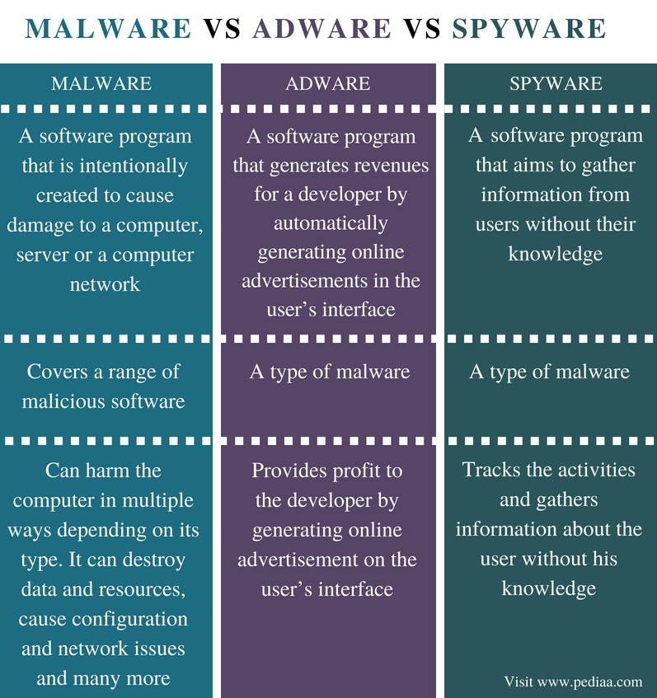
Difference Between Malware ,Adware And Spyware :

Slide 9
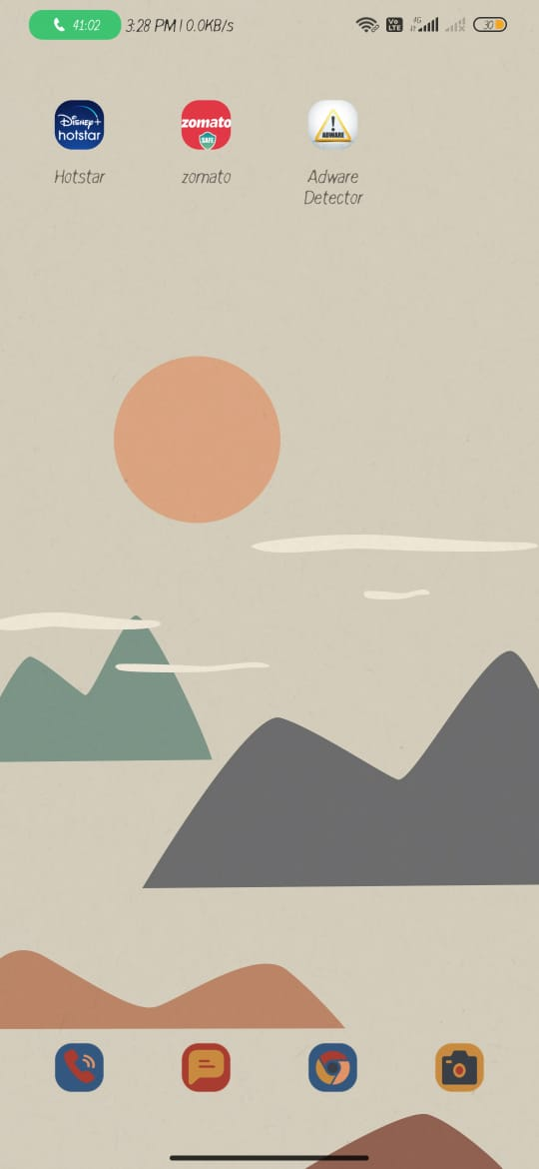
App Icon:
From the screenshot we can see an application named with Adware Detection.

Slide 10
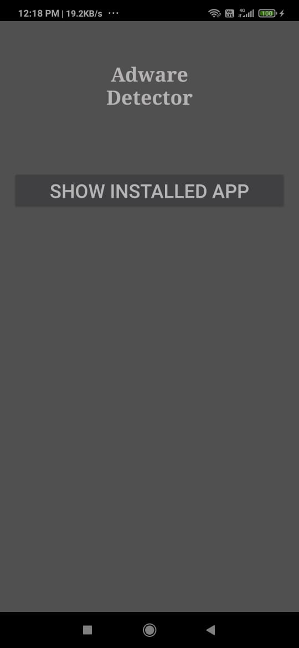
Landing page:
As soon as the application is started for the first time, the user find the
description of app and a button that leads to app list.

Slide 11
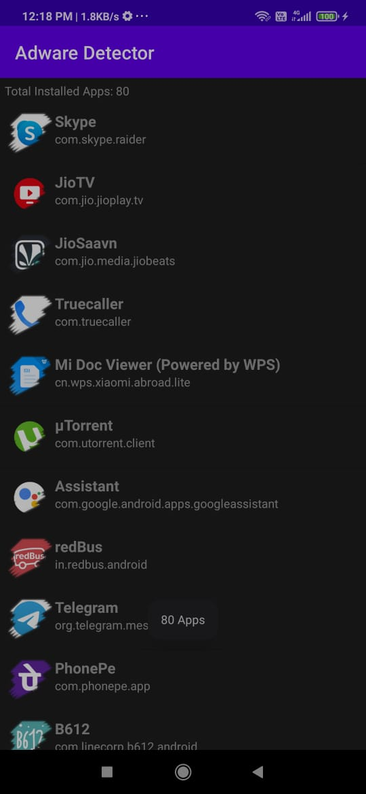
App list Page:
This is the apps list that we find after we click on the button given earlier.

Slide 12
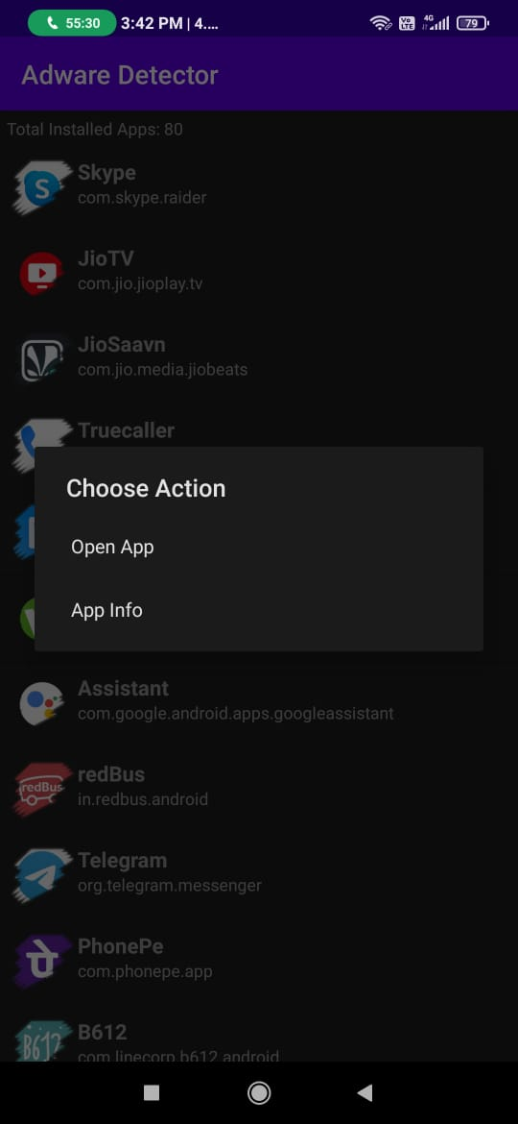
List of Action:
Whenever we click on any of the app in the given list, it makes us to choose action:
1. To open the app directly.
2. To open the app information in the phone settings

Slide 13

Praticipation In The Project :
We both reserched about the topic given to us and gain the knowledge of Adware in depth.
Frontend of the app like app icon and the layout of the main page is done by Nishank Shukla
The layouts of the app list page and the app list are maintained by Ankit Mishra.
The backend of the project is done by both after researching about the topic under the guidance of our mentor .
The documentation that consists ppt and the report is maintained by both after the discussion.

Slide 14
REFRENCES:
https://www.tutorialspoint.com/android/android_architecture.htm
https://meghsikshak.in/MeghSikshak_Public/

